Slide 1
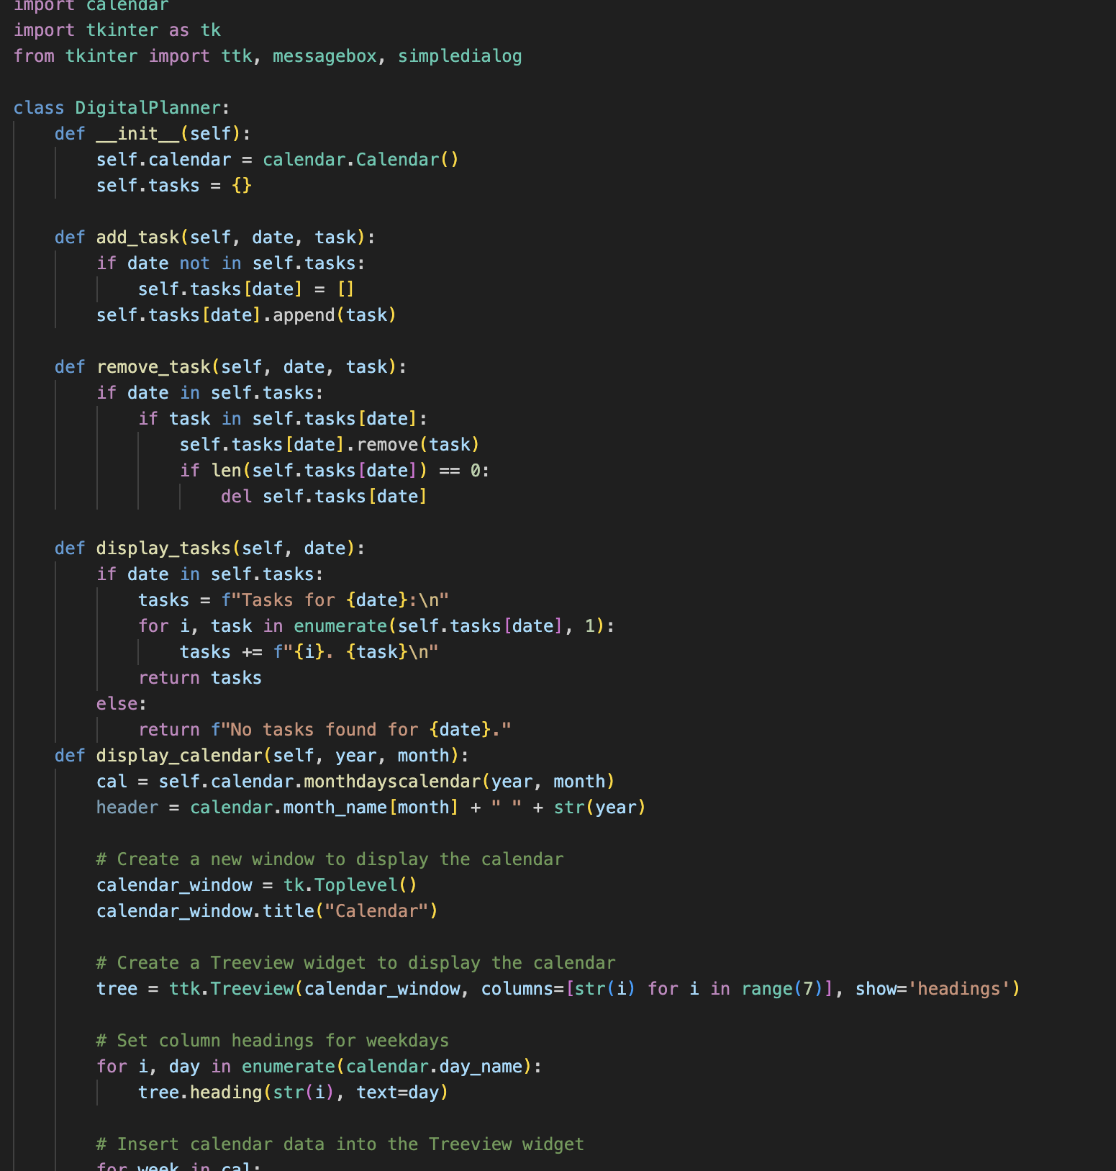
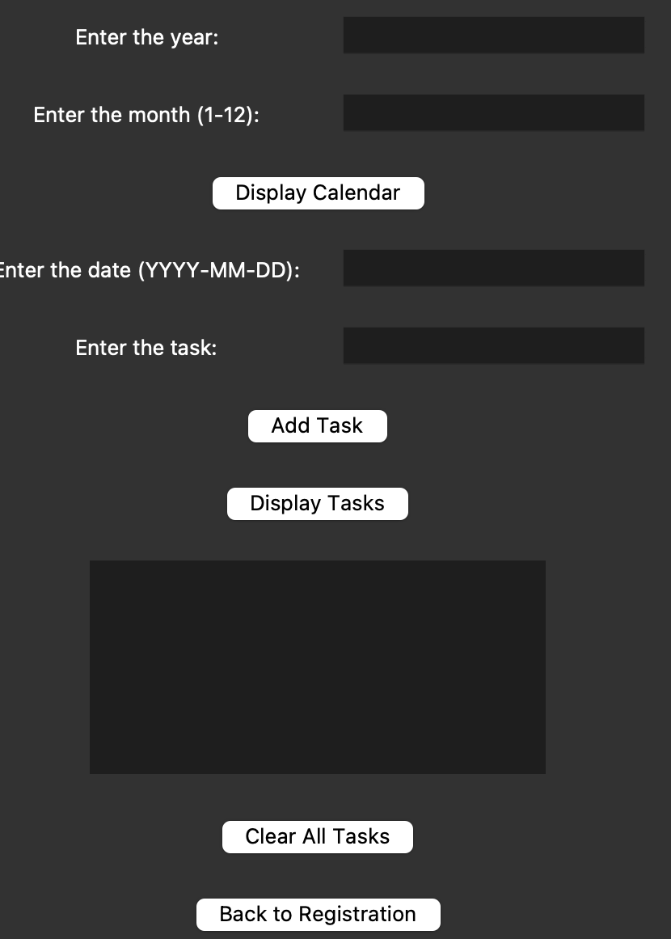
Digital Planner
"Stay Organized, Anywhere, Anytime - Your Personal Digital Planner!"
Team members :
Bianca De Almeida Azeredo & Alexa Guerra
https://github.com/ksu-is/digitalplanner/tree/main

Slide 2
Digital Planner
The Idea
Cost-effective and efficient alternative to traditional paper planners.

Slide 3
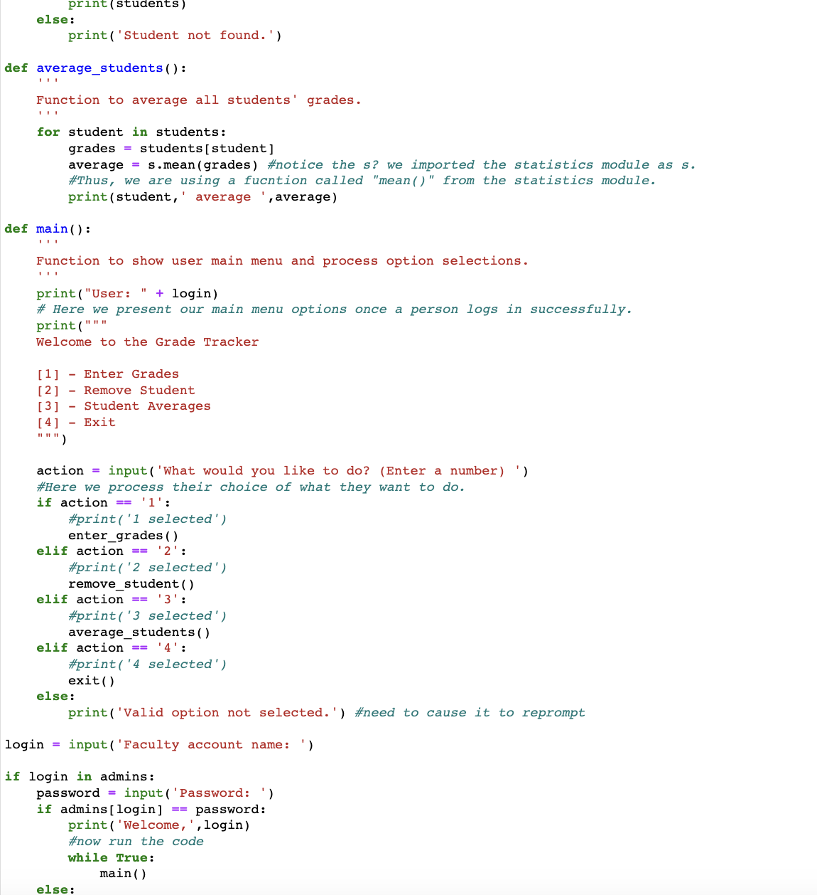
Digital Planner
Development Process
Built from scratch in Python; Inspiration from the Weekly Planner.
Tkinter interface

Slide 4
Digital Planner
Surprises & Scope
Ability to mark tasks as completed and display a monthly calendar.

Slide 5
Digital Planner
Overcoming Challenges
user authentication and integrating the calendar display.

Slide 6
Digital Planner
Let’s see
how it works!

